Slide 1

Tina Sansone
Past & Present Pathways
TN Genealogical Society
WELCOME!

Slide 2
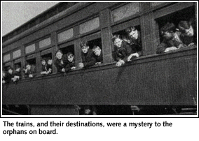
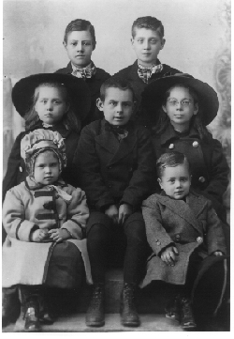
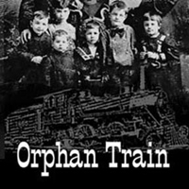
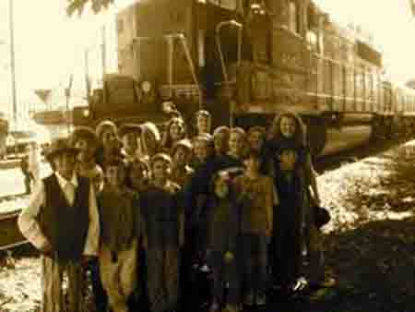
The Orphan Train

Slide 3
"I had the whole future ahead of me, and I didn't know what to expect." -- Elliot Bobo
Eighty years ago, Elliot Bobo was taken from his alcoholic father's home, given a small cardboard suitcase, and put on board an "orphan train" bound for Arkansas. Bobo never saw his father again. He was one of tens of thousands of neglected and orphaned children who over a 75-year period were uprooted from the city and sent by train to farming communities to start new lives with new families. Elliot Bobo's remarkable story is part ofThe Orphan Trains.

Slide 4
“The use of the term "orphan train" didn't come into use until the 1960s.
According to Charles Loring Brace, most of the children were American born of immigrant parents.”

Slide 7
Living conditions in these neighborhoods provided the perfect environment for pestilence & disease.
Children lost one or both parents to typhoid, dysentery, and small pox.
Dangers of work
factory & dock workers - injuries
Frequent layoffs
No programs like unemployment or workmen’s compensation
You don’t work, You don’t get paid!!!

Slide 8
By 1853, NYC filled with homeless kids
20,000-30,000 roamed the streets
Orphaned
Abandoned by parent(s)
Ran away from abusive parents/guardians

Slide 9
Survival Skills
Sold Newspapers, Coal & Rags
Pick Pockets
Begging
Singing on street corners
Prostitution
These kids had to fend for themselves!
Some were only 4 or 5, maybe younger with a teen caring for them.

Slide 10
Reverend Charles Loring Brace
Well educated
Ordained as clergyman
Worked with charities of New York
26 years old felt called to another calling
Noticed the kids on the street with no homes
Wanted to make a difference
Solicited the prominent members of community for financial support

Slide 11
Cont….
Told them without proper guidance, would end up turning to life of crime & depravity
Their support would make the neighborhood’s safer in the long run
Children’s Aid Society of New York (CAS) 1853

Slide 12
Children’s Aid Society of NY
Neighborhood Lodging
Food, Shelter & Clothes
Bible
Learn a skill – industrial schools
Girls – Housekeepers/Maids
The above was a good start, but too many kids and they needed a home…

Slide 13
Why not place these children who needed homes & guidance with rural families who needed help with the farm chores?
Take advantage of the Railroad
First company of kids went to Dowagiac, Michigan in September 1854.
46 kids & 2 agents

Slide 14
Who were these children?
Parents who turned their kids over hoping they would get a better life
Children from overcrowded orphanages
Prisons
Volunteers from the streets
NYC Child Welfare Dept turned over some of their kids
Some parents changed their minds, but no good record keeping on the kids, some had their names changed, no record of where they were even sent in some cases.

Slide 15
Emigration Dept of the Childrens Aid Society
Agents organized a route
Advertize thru newspapers & banners
Organize prominent people to approve families wishing to take in a child
These families could speak and “inspect” these kids before taking them in
Kids had a “say” if they wanted to go…
No food or lodging
Abusive homes
Some may even have been kidnapped?

Slide 16
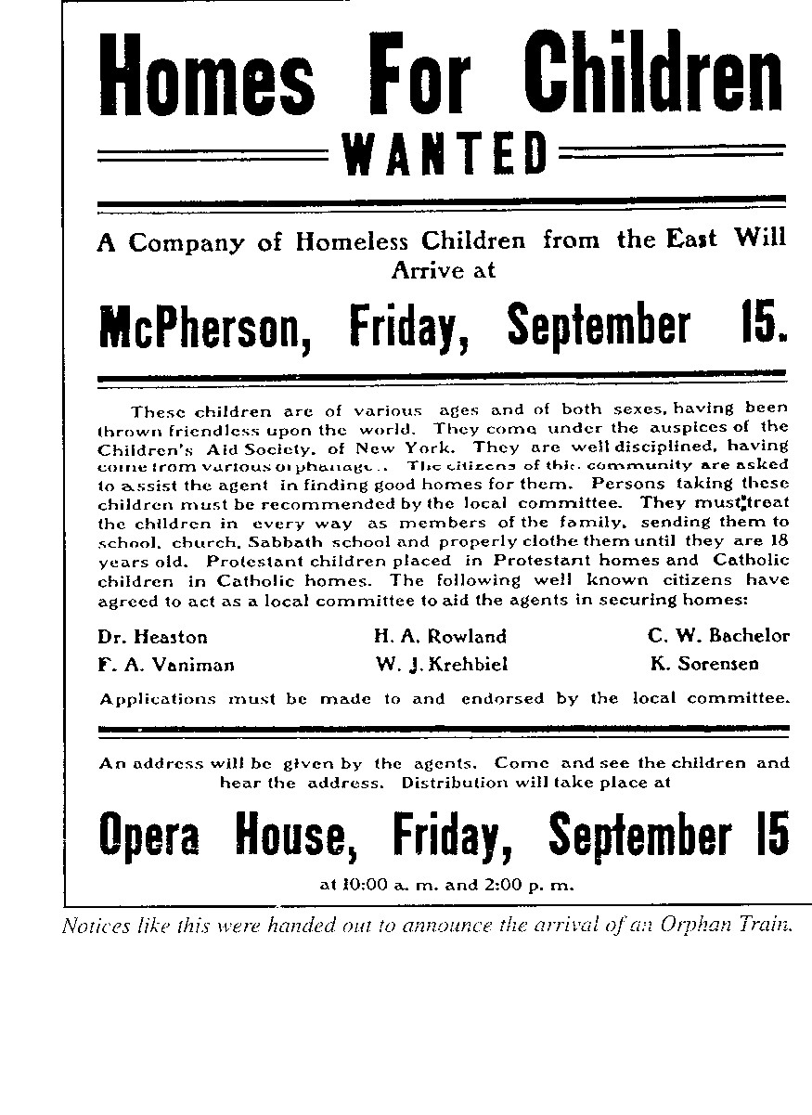
Reads as follows: These children are of various ages and of both sexes, having been thrown friendless upon the world. They come under the auspices of the CAS of New York. They are well disciplined, having come from various orphanages. The citizens of this community are asked to assist the agent in finding good homes for them. Persons taking these children must be recommended by the local committee. They must treat the children in every way as members of the family, sending them to school, church, Sabbath school and properly clothe them until they are 18 years old. Protestant children placed in Protestant homes and Catholic children in Catholic homes. The following well known citizens have agreed to act as local committee to aid the agents in securing homes:
Notes:
Reads as follows: These children are of various ages and of both sexes, having been thrown friendless upon the world. They come under the auspices of the CAS of New York. They are well disciplined, having come from various orphanages. The citizens of this community are asked to assist the agent in finding good homes for them. Persons taking these children must be recommended by the local committee. They must treat the children in every way as members of the family, sending them to school, church, Sabbath school and properly clothe them until they are 18 years old. Protestant children placed in Protestant homes and Catholic children in Catholic homes. The following well known citizens have agreed to act as local committee to aid the agents in securing homes:

Slide 17
Cont….
Families had to provide food, clothing, an education and nurture the kids until they became “of age”
Write the CAS periodically to tell about the child’s progress
At least once a year CAS would visit the homes
When a boy reached full age, he would receive $100 and a horse to start his adulthood.

Slide 18
Last official train left for Sulphur Springs, Texas in 1929
A child in almost every state of the Union
Between 1854 and 1929 an estimated 250,000 orphaned, abandoned, homeless children and poor families were placed in homes
Most states passes laws banning transport of children across state lines for adoption or foster placement
CAS continues today to better the lives of under-privilege kids & families in NYC

Slide 19
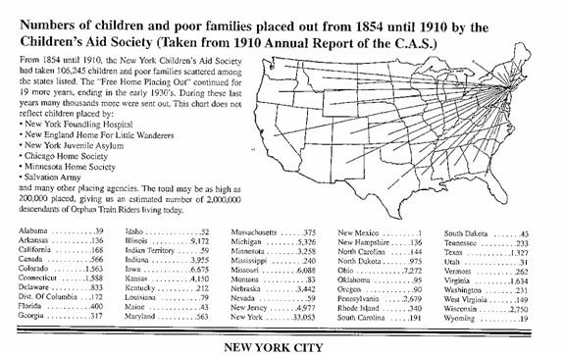
Distribution of Children
Notes:
56 year period

Slide 20
New York Foundling Home the Foundling
Est. 1869 by Sister Irene Fitzgibbon of the Sisters of Charity
Mission: to rescue infants from abandonment & death
Safe place to drop off infants with anonymity and not leave in an alley or throw in the river
Stayed until they were 2 years old, then placed with Catholic families

Slide 21
Cont.
Parents could make requests to hair color, eye color, sex, etc.
Tag placed on toddler with their name, birth date, a number and name of family they were being sent to.
Other programs
New York Juvenile Asylum
Boston Home for Little Wanderers

Slide 22
These organization had one thing in common…
They used the rail system as its mode of transportation!

Slide 23
The Children
Each had their unique story, but many refuse to talk about their previous life
Many were discouraged by the families they were place with in discussing their past
Being an orphan held a stigma in some places
Even as adults they did not talk about where they came from, if they even remembered

Slide 24
Mary Ellen Johnson Springdale, Arkansas
75 years of the Orphan Train slowly fading away with their stories not being told!
Mary Ellen was helping research for a County history book when she came across the newspaper story about kids dropped off in their area
She wanted to try to reunite some of these kids and arranged the first reunion
Arkansas Orphan Train Riders’ Reunion
Expected 25, but more than 100 arrived!

Slide 25
Orphan Train Heritage Society of America
Thru Mary’s efforts, the Orphan Train Heritage Society of America (OTHSA) was incorporated in 1987
Under her leadership, 5 Volumes of individual stories were published
An Archive containing data of more then 6,000 children collected

Slide 26
OTHSA moved headquarters to Concordia, Kansas in 2004 (right before Mary’s retirement)
2007 opened a museum using a renovated Union Pacific Depot and housed at the Morgan/Dowell Research Center
Preservation of these children’s stories will continue

Slide 27
Outcome….
Some placements successful
Some disastrous
Some abused & mistreated
Some received and loved by their families

Slide 28
Most that were interviewed are grateful for having been sent “out west” because they believe that the circumstances into which they were placed were better than those from which they came.

Slide 29
What became of kids?
Governors
Judges
Journalists
Merchants
Farmers
Outstanding citizens
Loving parents & spouses, kind neighbors

Slide 30
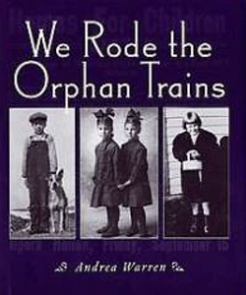
“They came by train and helped settle America. They deserve to be remembered!“

Slide 31
Children’s Aid Society (Placing –Out Department)
East 22nd Street, New York
United Charities Building
I, the undersigned __________________________________________________________________ hereby agree to provide for _______________________________________________________________ now of the age of ____________________________ years, until the said boy shall reach the age of 18 years, according to the following terms and conditions, and with the full understanding that the Society reserves the right to remove the child previous to legal adoption if at any time the circumstances of the home become such as in the judgment of the agent are injurious to the physical, mental or moral well-being of the child. The terms and conditions for the retention of the boy in my family being as follows: To care for him in sickness and health, to send him to school during the entire free school year until he reaches the age of 14 years, and thereafter during the winter months at least, until he reaches the age of 16 years; also to have him attend Church and Sunday School when convenient, and to retain him as a member of my family until he reaches the age of 17 years, and thereafter for the final year, until he is 18 years old, to pay the boy monthly wages in addition to his maintenance, the amount thereof to be previously determined after consultation with the Society’s local agent and his approval. In case he proves unsatisfactory, I agree to notify the society and pending his removal, to keep him a reasonable length of time after such notice has been given. I agree, moreover, to use my best endeavor then and at all times, to detain him, should he try to leave me, until the Society can take steps for his removal. I agree to keep him at all times as well supplied with clothing as he was when I received him. I agree to write to the Society at least once a year, and should I change my address I will notify the Society. __________________________________ Witness, ___________________________________ ___________________________________ Date, ______________________________________ HAVE THIS NOTICE AND RECEIPT IN YOUR HAND WHEN TRAIN ARRIVES

Slide 32
Common Primary Sources
Diary Entries
Magazine or Newspaper Articles
Photographs
Audio and Video Recordings
Memoirs
Speeches
Interviews

Slide 33
Secondary Sources
A source written after the event occurred
Combines research of many primary sources
Often a published work

Slide 34
Common Secondary Sources
Classroom textbook
Essays
Biographies
Documentaries
Any books written about a period or event in history

Slide 35
Analyzing Secondary Sources
Benefit of secondary sources
- Author can combine several points of view
Disadvantage of secondary sources - The author is not an eyewitness

Slide 36
Prime Time
Here are two primary resource photos from the Library of Congress online “American Memory” collection entitled, “Immigrants on Atlantic Liner” and “Mulberry Street, New York City” from around 1900.

Slide 37
Do you have an Orphan Train Ancestor?
Research Registry

Slide 38
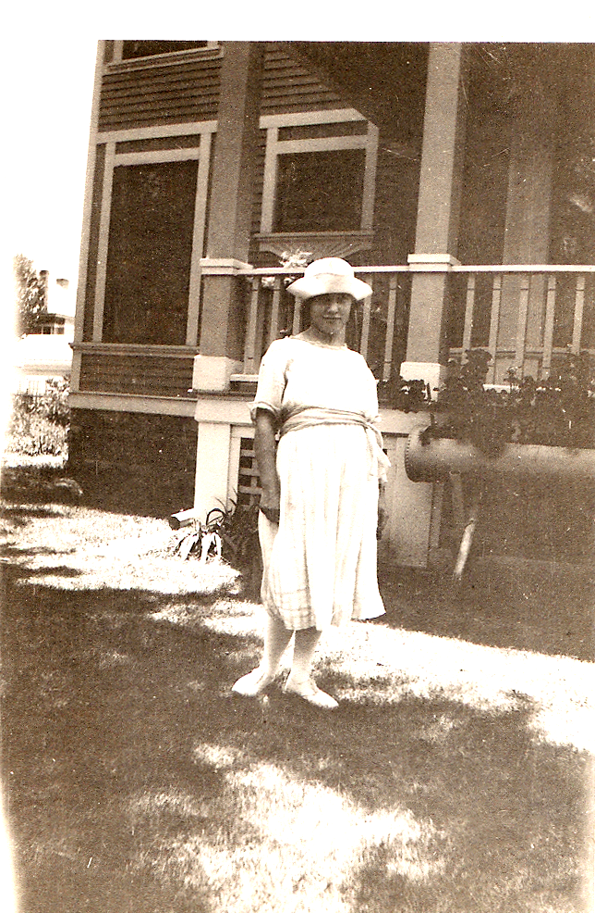
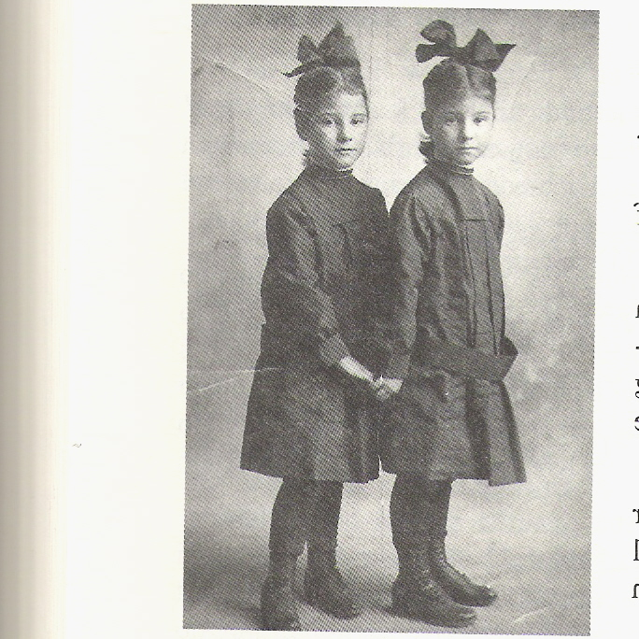
Two Orphan’s Story
Nellie S. and Nettie M. Crook
Nettie Crook

Slide 39
Nettie on left and Nellie on right. Taken in McPherson in January 1913 when they were age seven.
Their father was a farmer and heavy equipment operator. He worked on the Erie Canal and other places in New York and was gone from home.
Their mother married at 16, and was home sick a lot for her family. She would leave the children to go home to Burlington, Vermont.
They were identical twins, but were also “mirror imaging”. Nettie is right-handed, Nellie is left. Nettie’s curls go clockwise and Nellie are counterclockwise swirls. Many times when they were separated and longing for each other, they would look in in the mirror and see the other girl.
In 1910 they were living in NY. Nellie remembered the day when her, her sister, and their brother were taken away. She said, “Mother had Nettie on one knee and me on the other. I said ‘Mama why are you crying?’ ‘I’m not crying,’ she said and she was trying to smile. But just then the man came with the dray wagon to take us to the orphanage”.
They were placed in the Kingston Orphan’s Home. They were told to break all ties with the past and given new birth dates. Later, they tried to find their records at the Orphanage, but were told they burned in a fire.
They left on Sept. 11, 1911. Leon was left behind.
In Kansas City, they were put on a bench to sing “Jesus Loves Me This I Know” to draw a crowd. They were escorted by Anna Hill.
In McPherson, most of the children were taken, but the girls didn’t want to be separated, so Hill took them to Canton KS.
Chapin family. Mrs. Chapin was not nice. After 16 months, Hill came to get them. Darrah family.

Slide 40
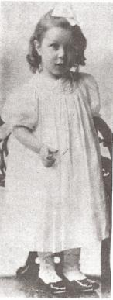
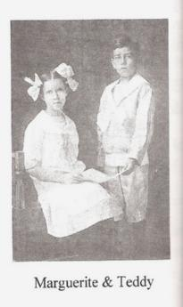
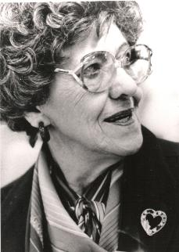
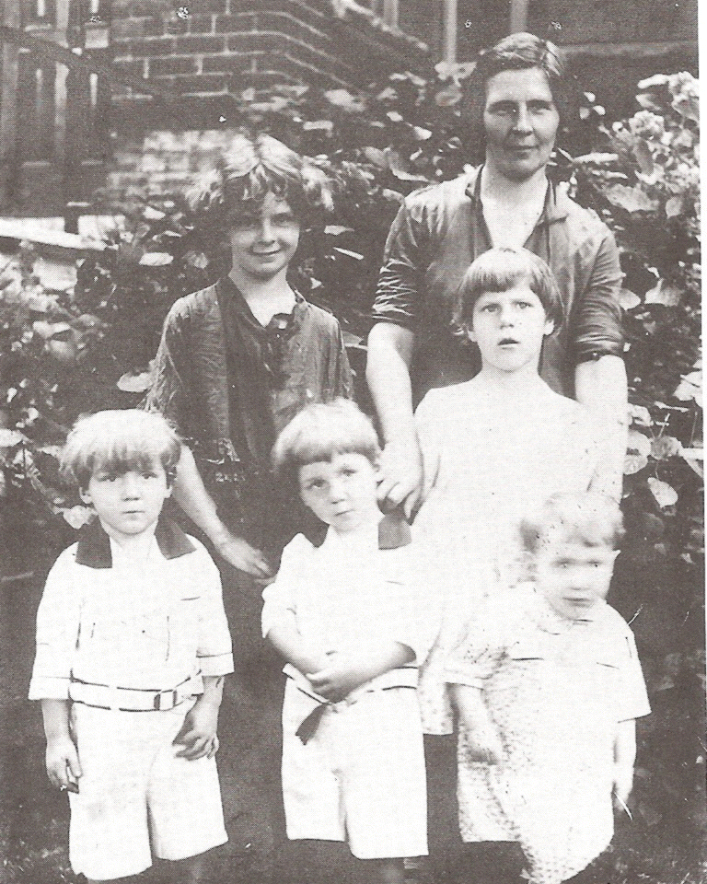
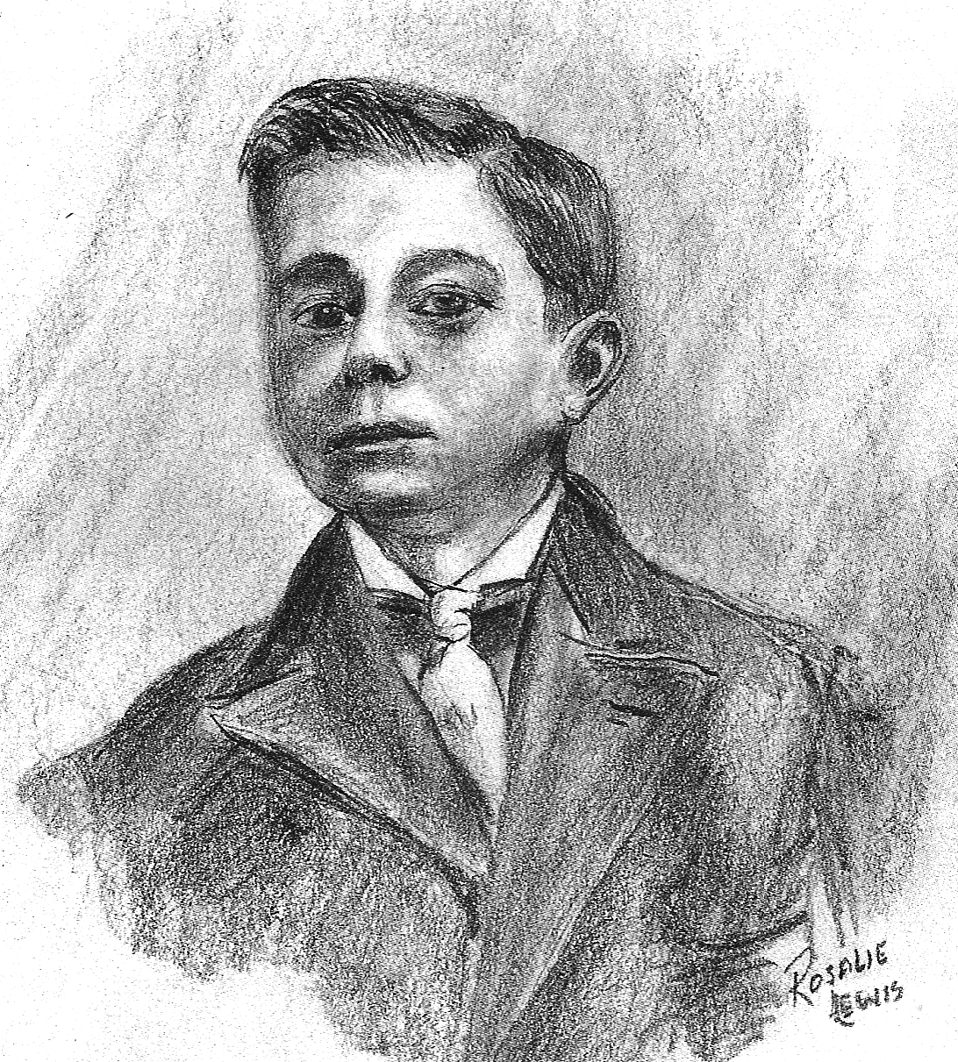
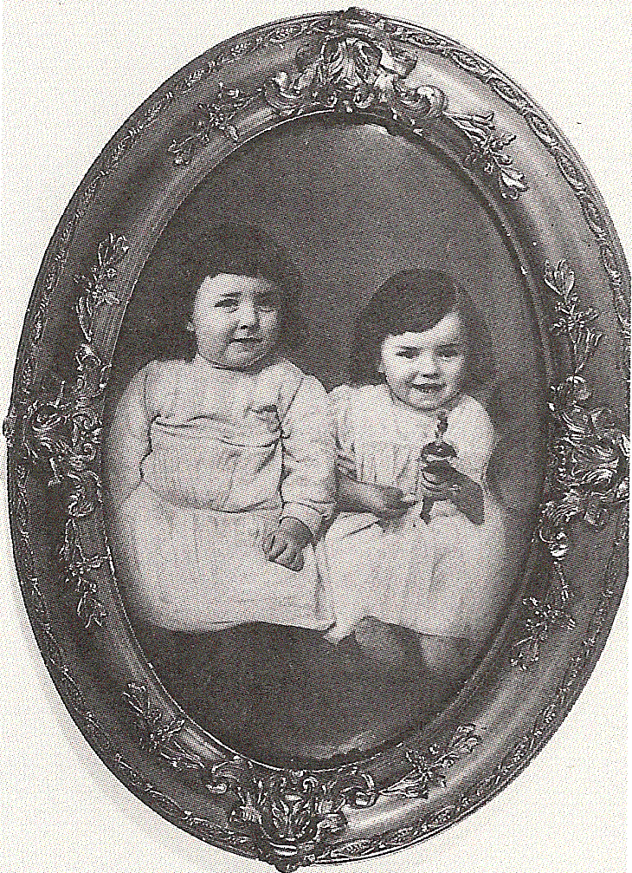
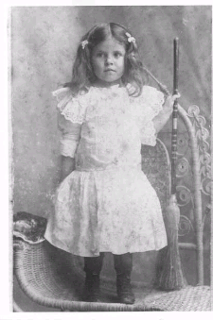
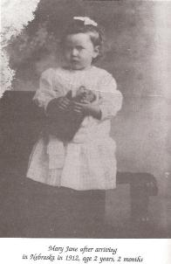
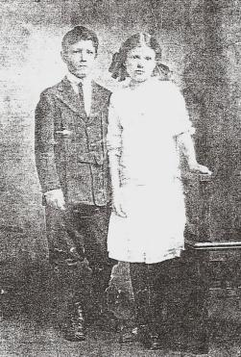
Jean
John
Irma Craig

Slide 41
Sources
National Genealogy Society Magazine, July-September 2007, “They came by train: Orphan train riders”, Becky Higgins
Becky is from Illinois and a genealogist
In 2007, was President of Orphan Train Heritage Society of America, APG and Speakers Guild.
She lectured about the Orphan Train
Had a great-grandfather, William Sydney Emay, that was an early orphan rider at the age of 8 in 1862. He went from New York to Rush County, Indiana.

Slide 42
Resources cont…
Brace, Charles Loring. The Dangerous Classes of New York & Twenty Years’ Work Among Them. 1872.
Burrows, Edwin G. & Mike Wallace. Gotham, A History of New York City to 1898.
Orphan Train of Kansas

Slide 43
Resources cont…
Trammell, Rebecca S. “Orphan Train Myths and Legal Reality.” The Modern American, Spring 2009, 3-13.
Rebecca Trammell
Dolly & Homer Hand Law Library Director, Director of Electronic Education, and Professor of Law
Advanced Legal Research in Elder Law, Advanced Legal Research, Cyber Law Seminar, Research and Writing II

Slide 44
Genealogy
Cyndi's List - Orphan Trains
IA Gen Web Orphan Train Project
Orphan Train of Nebraska
Has obits…

Slide 45
Websites
Orphan Train Heritage Society of America, Inc. National Orphan Train Complex Orphan Train Riders History (by Howard Hurd) Reverend H.D. Clarke (Children’s Aid Society Agent) Transcript of “The American Experience” PBS documentary Orphan Trains of Kansas Children’s Aid Society Orphan Trains to Wisconsin Orphan Train Riders Blog

Slide 46
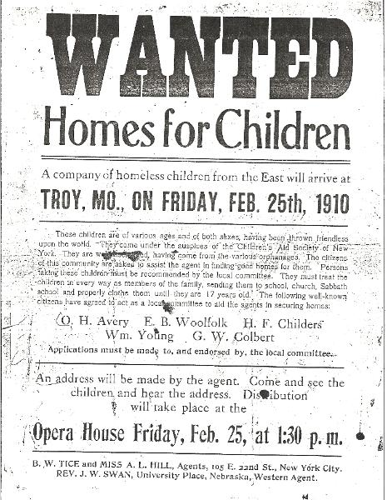

Slide 47
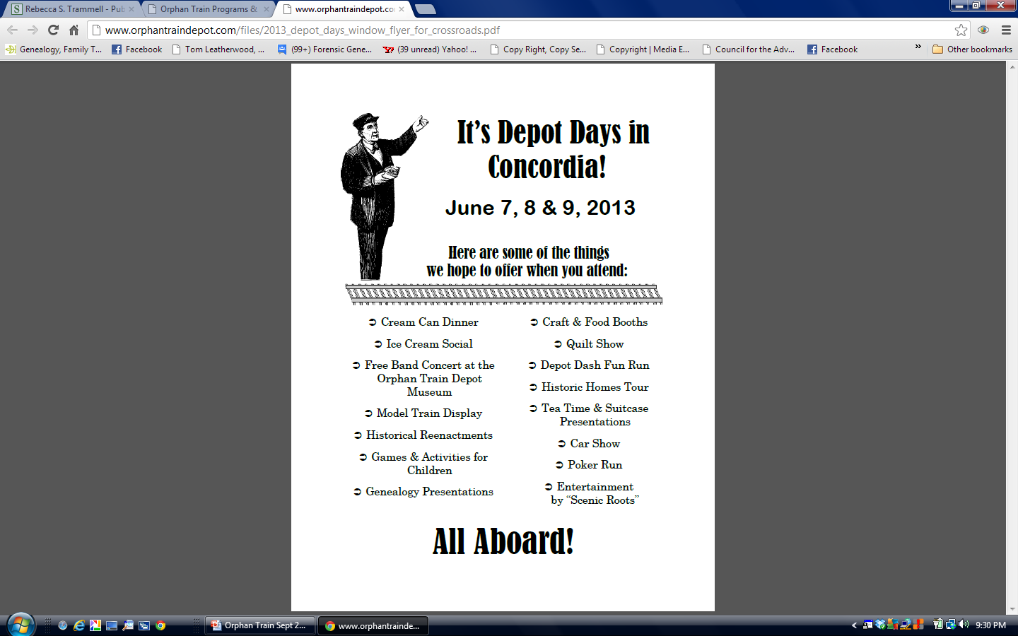

Slide 48
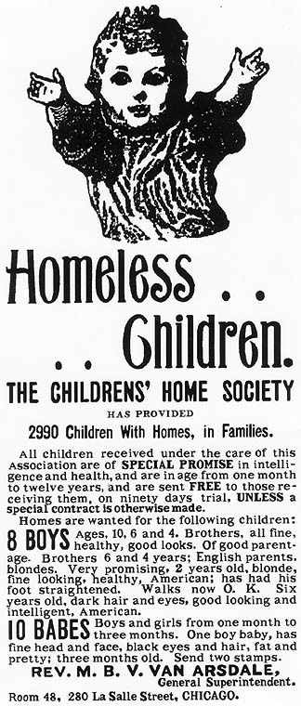
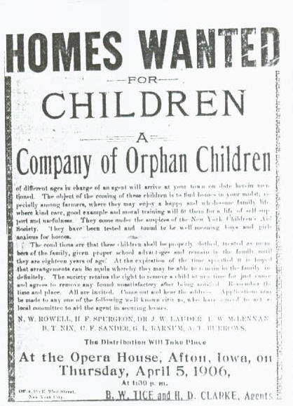
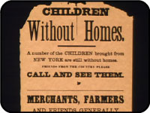

Slide 49
DNA
Family Tree DNA - Orphan Train
Orphan Train DNA Project
Orphan Train the movie 1979

Slide 50
Thank you for coming!
Tina Sansone
TN Genealogical Society
www.tngs.org
tinahsansone@gmail.com

